Slide 1
MRI Pulse Sequence Programming
Ex1.16: B0 Distortion correction in EPI
Presented by:
Utkarsha Shukla

Slide 2
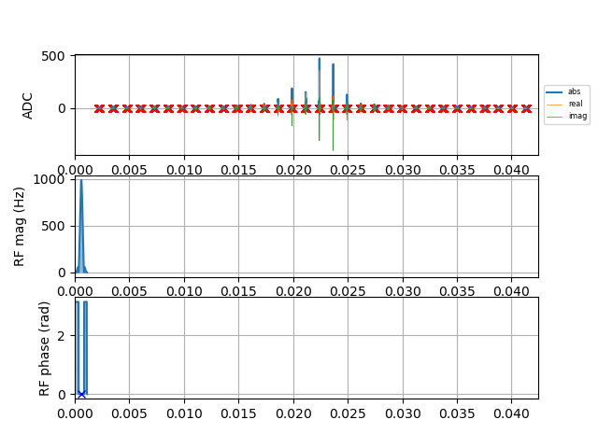
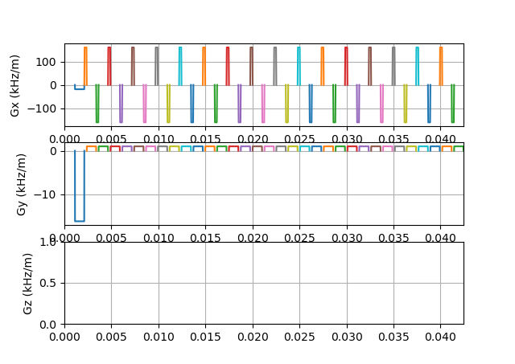
Echo Planar Imaging
Unlike conventional MR techniques, EPI requires a single excitation pulse and whole k-space
is sampled in a continuous trajectory.
Since the decay of signal is governed by T2 and field inhomogeneity, the acquisition should be
complete within 50ms-100ms.
Advantage- Complete use of spin magnetization and Signal-to-noise ratio is high.
Disadvantage- Makes the system vulnerable to inhomogeneities

Slide 3
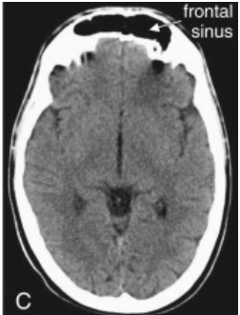
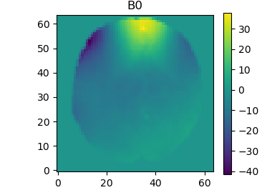
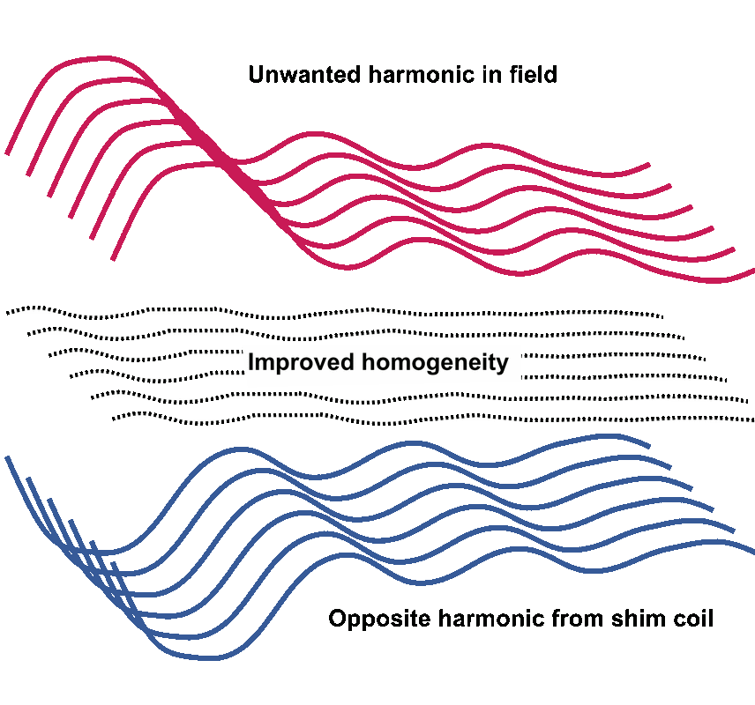

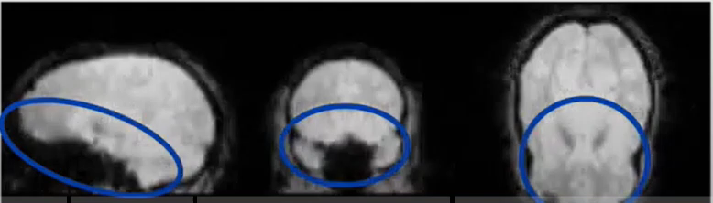
Causes for B0 Distortion
Main cause is residual magnetic field inhomogeneity, due both to the external room temperature shim coils not being optimally set and high order internal magnetic field inhomogeneities in the sample, which cannot always easily be shimmed out using external coils.
Here, the disturbance is due to air-tissue interface.
Shim coils
Inhomogeneous B0
Signal Loss
Homogeneous B0

Slide 4
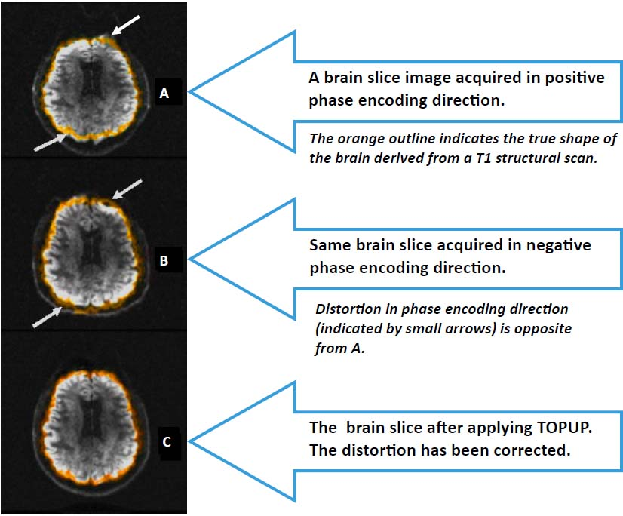
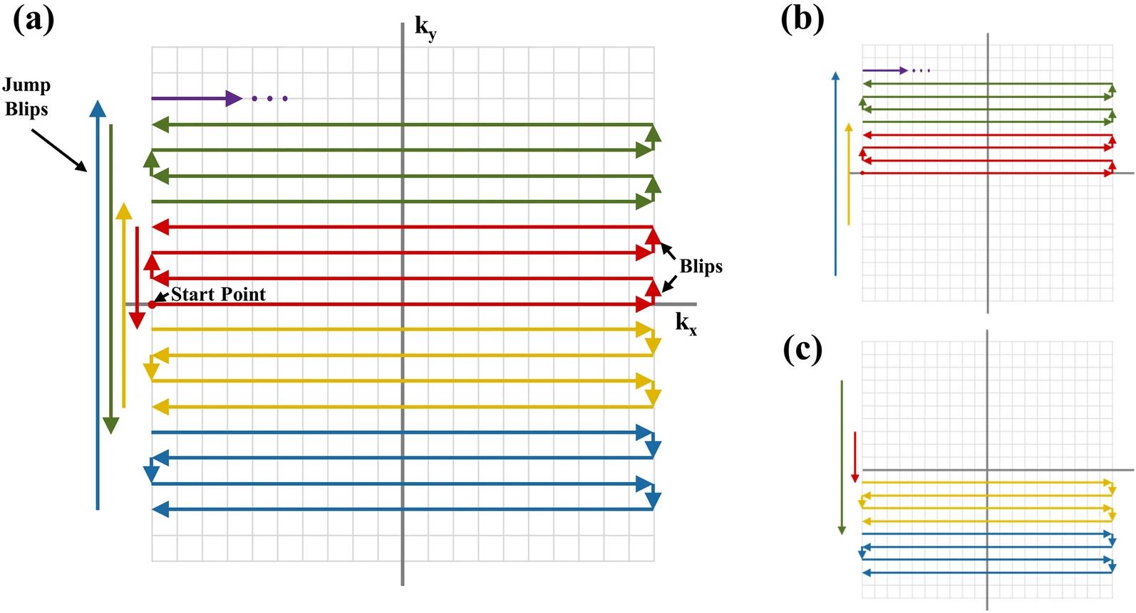
Methodology
Distortion occurs in Phase-Encoding direction
Blips up and blips down in a single k-space, using 2 different k-spaces in my code
Toolbox: FSL
1. 1. Hwang, SH., Lee, HS., Choi, S.H. et al. Distortion correction using topup algorithm by single k-space (TASK) for echo planar imaging. Sci Rep 13, 18751 (2023).
2. fmri.ucsd.edu/Howto/3T/DTI-TOPUP.html

Slide 5
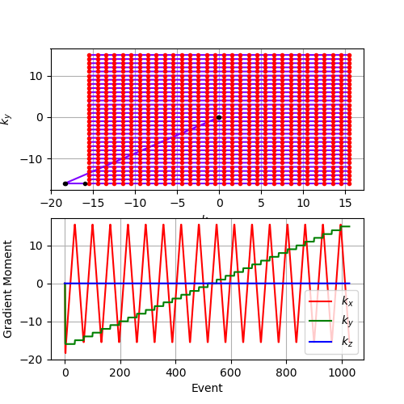
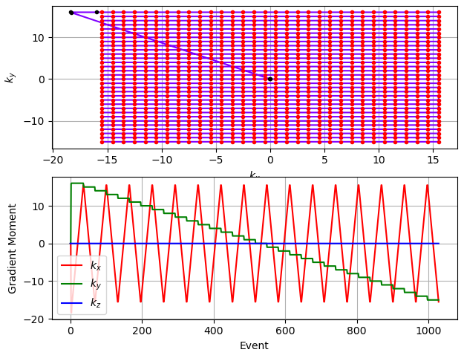
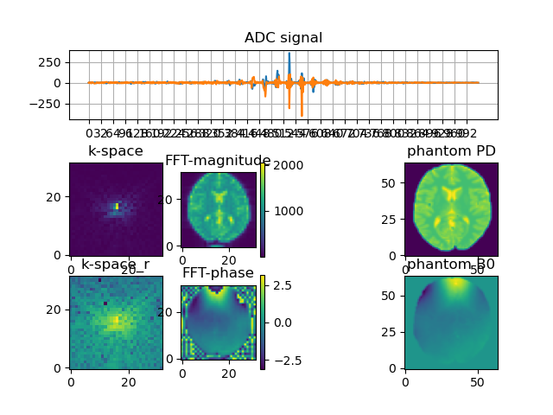
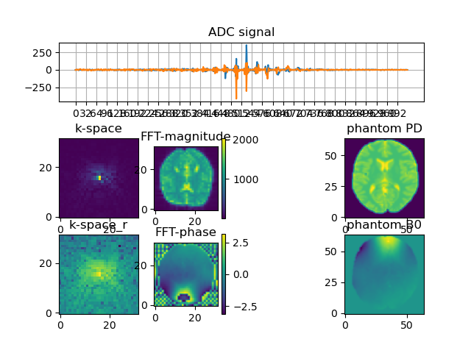
Positive-Encoding(+ve blips)
Negative-Encoding(-ve blips)
Sign reversal of the effects of ΔB0

Slide 6
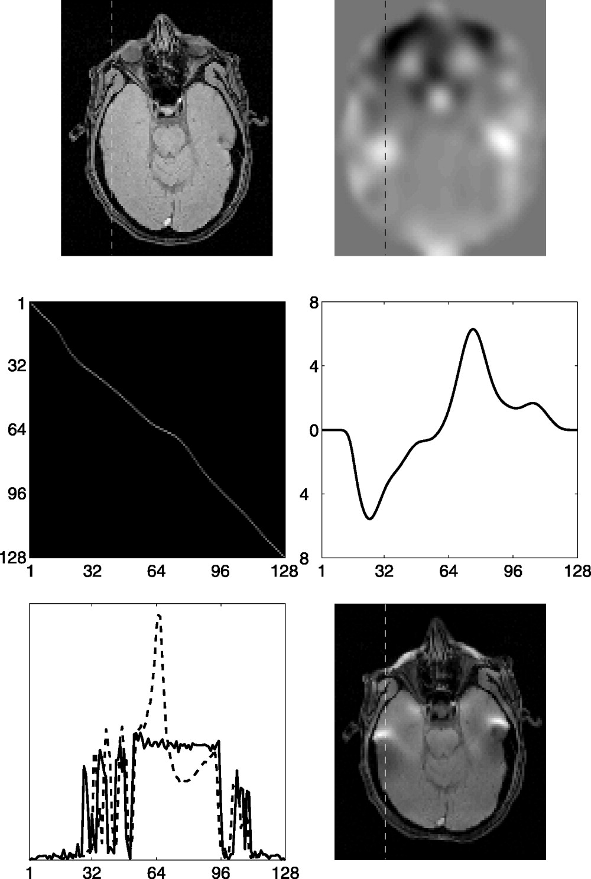
Approach: Top-Up Distortion Algorithm
Magnitude
Phase
Use Gradient Echo or blip reversed EPI
Field-Map to measure deviations in B0 and Signal Loss
Unwarp with the field map to improve image registration
Deweight area with substantial signal loss during registration
Displacement of each pixel along the the line
Intensity profile along the line
2. Jesper L.R. Andersson, Stefan Skare, John Ashburner, How to correct susceptibility distortions in spin-echo echo-planar images: application to diffusion tensor imaging,

Slide 7
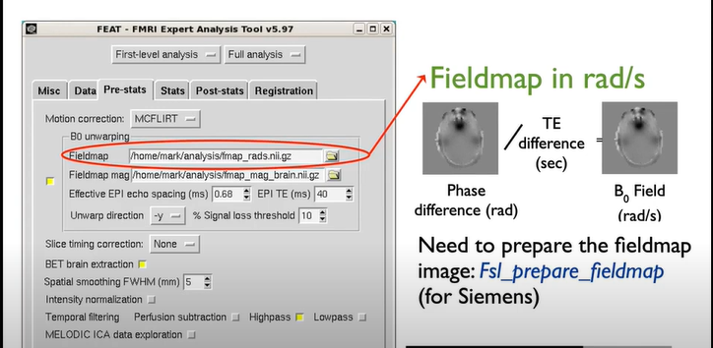
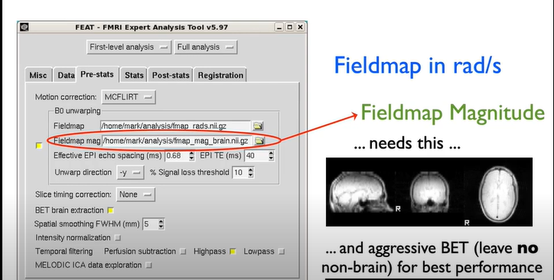
Distortion correction within FEAT
fsl.fmrib.ox.ac.uk/fslcourse

Slide 8
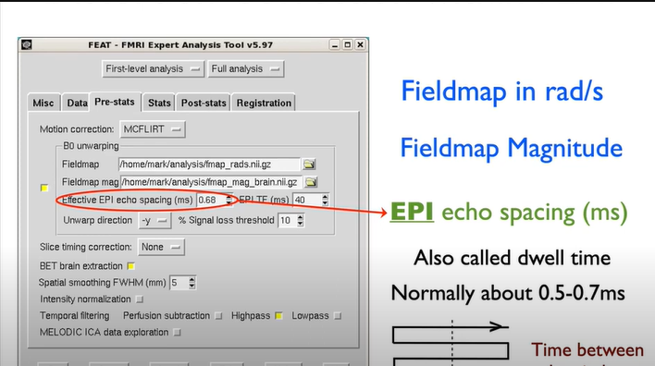
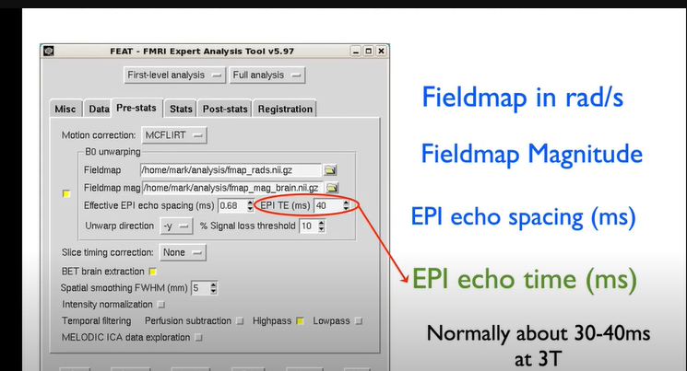
fsl.fmrib.ox.ac.uk/fslcourse

Slide 9
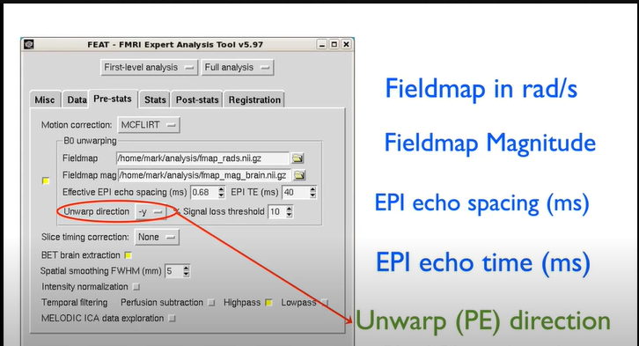
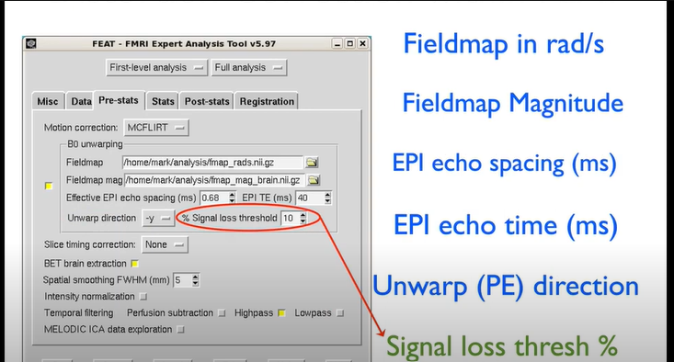
fsl.fmrib.ox.ac.uk/fslcourse

